Slide 1
REVIEW
□HTML □ CSS □ DOM

Slide 2
HTML, review
TAGS <body>
OPENING TAG <p>
CLOSING TAG </p>
ELEMENT <p>This is my first paragraph</p>
EMPTY ELEMENT <br/>
NESTED ELEMNTS <body> <p>This is my second paragraph</p> </body>
ATTRIBUTES <a href=“http://vlad.com.au”>Vlad</a>
(always in pairs NAME=“VALUE”)
href is the name of the attribute for tag <a>
http://vlad.com.au is the value of the attribute for tag <a>

Slide 3
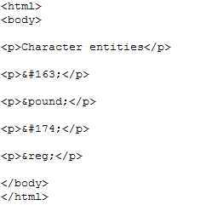
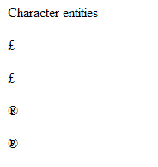
Special characters

Slide 4
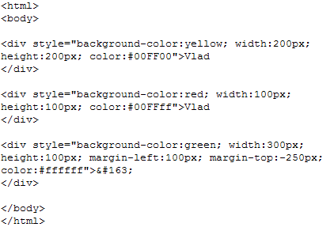
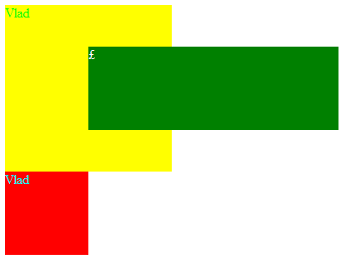
<div>
Defines a division or a section in a HTML document

Slide 5
<meta>
Some search engines on the WWW will use the name and content attributes of the meta tag to index your pages
<meta> tags are nested inside the <head> tag
<head>
<meta name="description" content="Free Web tutorials on HTML, CSS, XML, and XHTML" />
<meta name="keywords" content="HTML, DHTML, CSS, XML, XHTML, JavaScript" />
</head>
THIS IS NOT A GOOD PRACTICE, it is not fair !
<meta name="description" content="Free free free free free free free free free free free free free free free free free free free free free free free Web tutorials on HTML, CSS, XML, and XHTML" />

Slide 6
Valid HTML
elements must be properly nested
elements must always be closed
elements must be in lowercase
documents must have one root element (<html>)
attribute names must be in lower case
attribute values must be quoted
have the minimum following tags:
<!DOCTYPE html PUBLIC "-//W3C//DTD XHTML 1.0 Transitional//EN”
"http://www.w3.org/TR/xhtml1/DTD/xhtml1-transitional.dtd"> <html> <head> <title>simple document</title> </head> <body> <p>a simple paragraph</p> </body> </html>

Slide 7
Correct or not?
<b><i>This text is bold and italic</b></i>
<b><i>This text is bold and italic</i></b>
<p>This is a paragraph
<p>This is a paragraph</p>
A break: <br>
A break: <br />
<P>This is another paragraph</P>
<p>This is another paragraph</p>

Slide 8
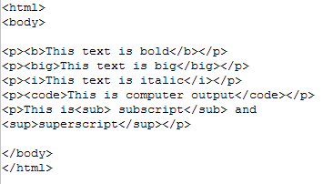
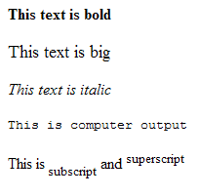
HTML - Formatting tags
For big websites writing formatting tags could create problems.
(Imagine trying to change the colour of an element in hundreds of places...a lot of time spent and coffee!)

Slide 9
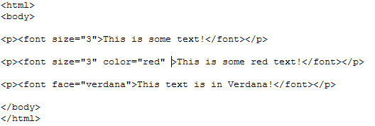
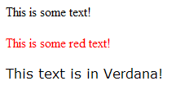
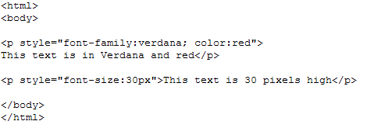
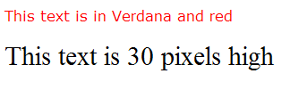
STYLES (introduced in HTML version 4.0, to provide a common way to style all HTML elements)
Without styles:
With styles as attributes:

Slide 10
More examples:
<h1 style="text-align:center">
<p style="font-family:courier new; color:red; font-size:20px">
<body style="background-color:yellow">

Slide 11
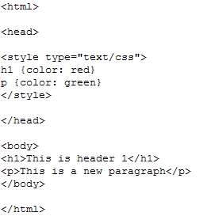
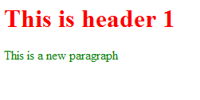
STYLES
Could be inside the tag (like in the previous examples called INLINE) or in a separate part of the document, usually in the <head> part and called INSIDE:

Slide 12
STYLES
Could also be EXTERNAL when all the formatting styles are stored in a separate file (external style sheet)
It is ideal when the style is applied to many pages
With an external style sheet, you can change the look of an entire Web site by changing one file
Each page must link to the style sheet using the <link> tag:
<head> <link rel="stylesheet“ type="text/css" href="mystyle.css"> </head>

Slide 13
CSS
(cascade style sheet)
Browser default
External style sheet
Internal style sheet (in the head section)
Inline style (inside an HTML element)
PRIORITY
Multiple Styles Will Cascade into One

Slide 14
reads
the external CSS formatting file
the main HTML file
reads

Slide 15
Example of external CSS
body
{
font-size:75%;
font-family:verdana,arial,'sans serif';
background-color:#FFFFF0;
color:#000080;
margin:10px;
}
h1
{
font-size:200%;
}
h2 {font-size:140%;}
th {background-color:#ADD8E6;}
ul {list-style:circle;}
ol {list-style:upper-roman;}
a:link {color:#000080;}
a:hover {color:red;}

Slide 16
Syntax
selector {property1:value1}
selector {property1:value1; property2:value2}
body {color:black}
p {font-family:"sans serif"}
p {text-align:center; color:red}
p { text-align:center; color:black; font-family:arial }
h1,h2,h3,h4,h5,h6 { color:green }

Slide 17
Syntax
classes
Define classes in CSS:
p.right {text-align:right}
p.center {text-align:center}
Using classes inside the code:
<p class="right">This paragraph will be right-aligned.</p>
<p class="center">This paragraph will be center-aligned.</p>

Slide 18
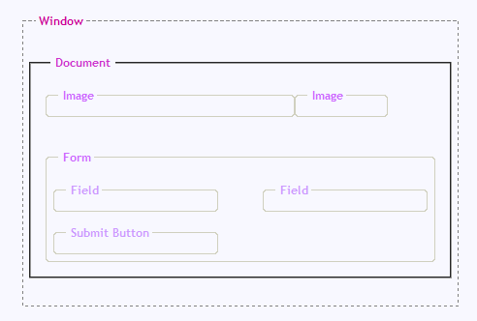
DOM?
Document Object Model - the hierarchical description of how the objects that make up a page are connected together
Using this model we can gain access to each object's properties and methods and manipulate them
"In other words: The HTML DOM is a standard for how to get, change, add, or delete HTML elements" (W3schools)
To access any objects (called NODES) we use the “dot syntax”
For example to access the “form” object (node) we write:
window.document.form

Slide 19
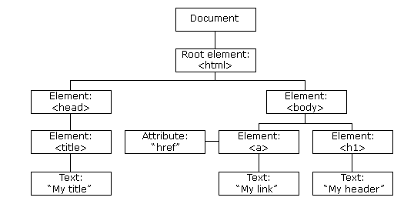
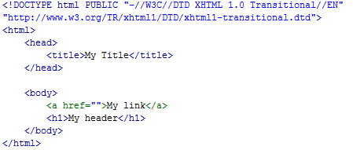
NODES
everything in an HTML file is made of NODES
including the text and attributes

Slide 20
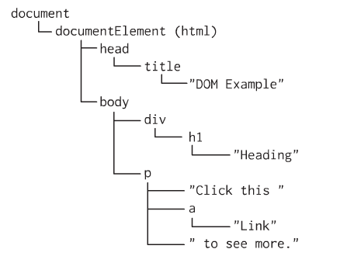
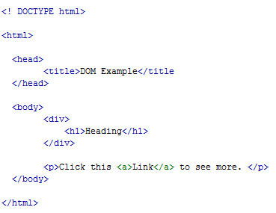
NODES
another example with another way of showing the TREE structure
parents, children and siblings nodes

Slide 21

NODES
all nodes could have an ID assigned to them
like any objects, nodes have their way of being accessed using properties and methods
PROPERTIES to find something that exists
nodeName
nodeValue
nodeType
...
METHODS to do something (actions)
getElementByID(nodeID)
getElementByTagName(name)
createElement(tagName)
appendChild(node)
...
the most used property is "getElementById(nameID)"
the easiest way to see and change the value of an element is to use: "innerHTML" property (supported by all browsers, created for IE)

Slide 22
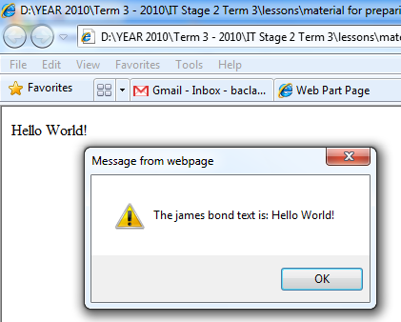
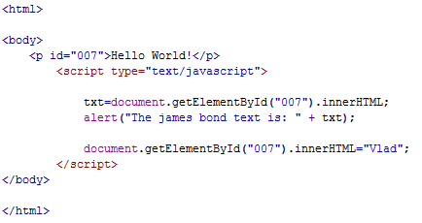
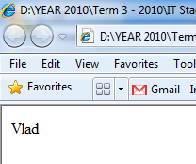
retrieving and changing an element's value

Slide 23
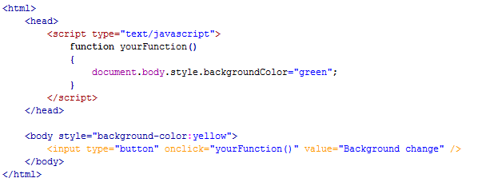
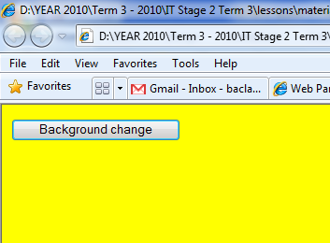
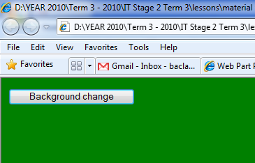
changing element's value using EVENTS

Slide 24
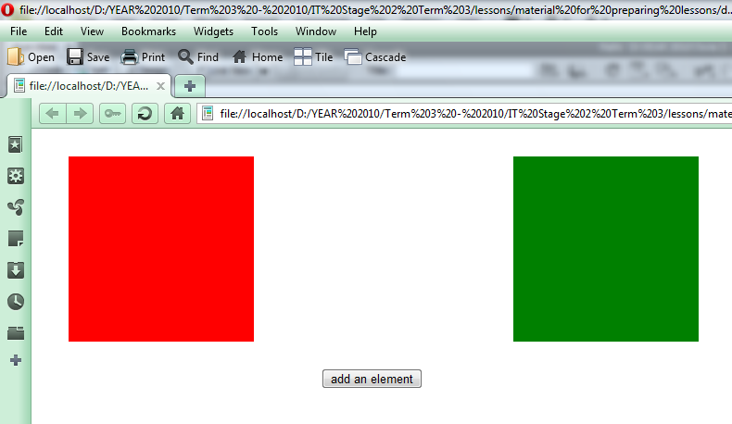
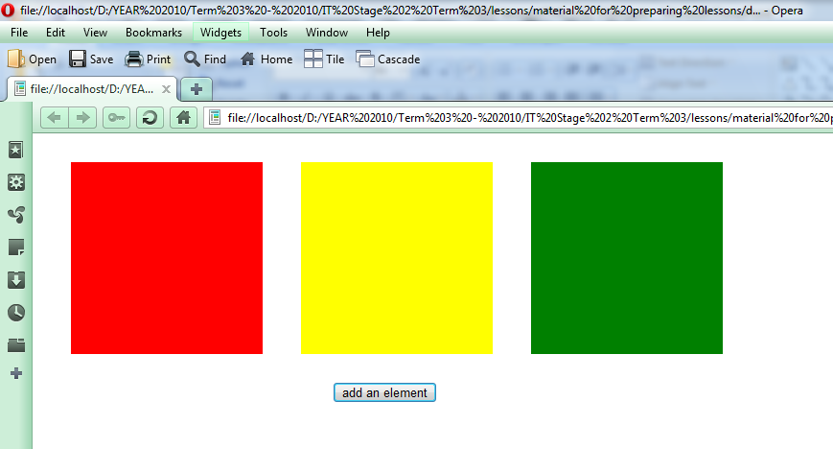
adding an element...

Slide 25
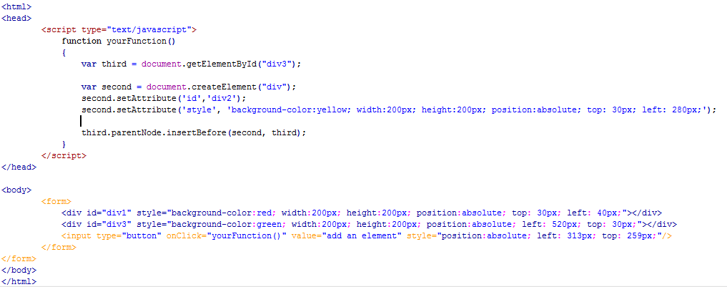
adding an element...
a very large repository of examples could be found here:
yes, here...there

Slide 26
Collections/Arrays
When the page finish to load, the browser creates arrays for all images, anchors, links and forms, so all images will be in a images[] array, the forms in a forms[] array and so on
Using arrays with index location
To access them we use the dot syntax: window.document.images[3]
for the forth image stored
Using arrays with names specification
Or using names: window.document.images[“sunshine”]
for the image stored as <img src=“somelocation.png” name=“sunshine” />
!check the lecture about OBJECTS to find more about NATIVE and USER DEFINED objects!
!check here all the API for HOST (browser) objects!
here

Slide 27
Collections/Arrays
The forms[] array created contains another array called elements[] that contains all the buttons and forms from that form
To access “Submit Button” (lets say it has name=“submitButton”) in the form called “form” we can write any of the followings:
window.document.forms.submitButton.value
window.document.forms[0].elements[2].value
window.document.forms[“form”].elements[“submitButton”].value

